Slide 1

Welcome To Presentation
on
Line Plot
Sunil Chaudhary, 13
Sanam Tamang,14

Slide 2
Introduction
A line plot, also known as a dot plot or line graph, is a basic type of chart that represents data points using dots or markers placed along an axis. It is a visual representation of data distribution and frequency, particularly for smaller datasets. Each dot on the line plot represents an individual data point, and the dots are connected by lines to show the sequence. Line plots are useful for displaying categorical or discrete data and are commonly used in education, research, and data analysis to present information in a concise and accessible manner.

Slide 3
Pros
Pros:
Simplicity: Line plots are easy to understand and interpret, making them suitable for presenting data to a wide range of audiences, including students and non-experts.
Clarity: Line plots allow for a clear visualization of the distribution and trends in the data, making it easier to identify patterns, outliers, and clusters.
Compact representation: Line plots are particularly useful for small to moderate-sized datasets, as they can display all the data points on a single chart, providing a comprehensive overview of the data.
Comparison: Line plots enable easy comparison between different categories or groups, as multiple lines can be displayed on the same plot, facilitating visual analysis and drawing conclusions.

Slide 4
Cons
Limited for large datasets: Line plots may become cluttered and difficult to interpret when dealing with a large number of data points
Precision limitations: Line plots may not accurately represent the exact values of data points since they rely on dot placement and connections. This can lead to potential misinterpretations or inaccuracies in understanding the data.
Limited for continuous data: Line plots are best suited for representing discrete or categorical data. When dealing with continuous data, other types of graphs, such as line graphs or scatter plots, may provide more appropriate representations.

Slide 5
Types
Basic Line Plot
Multiple Line Plot
Time Series Plot

Slide 6
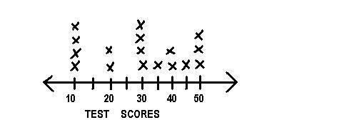
Basic line plot
This is the most common type of line plot, where data points are plotted as dots or markers along a number line or an x-axis, and they are connected by straight lines. It is used to display the distribution and frequency of data values.

Slide 7
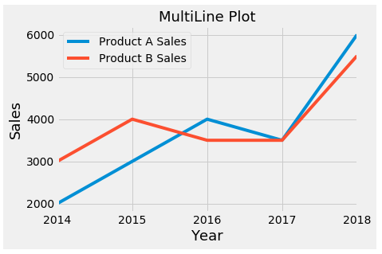
Multiple line plot
In a multiple line plot, multiple lines are plotted on the same chart, each representing a
different category, group, or data series. This type of line plot allows for easy comparison and
analysis of multiple datasets.

Slide 8
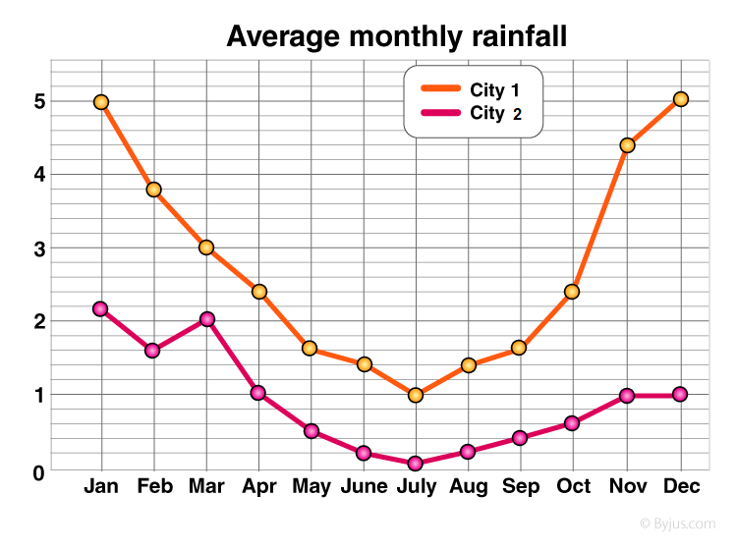
Time series line plot
A time series plot represents data points collected over time. The x-axis represents the time variable, such as days, months, or years, while the y-axis represents the corresponding values. Time series plots are commonly used to visualize trends and patterns in data over time.

Slide 9


